Slide 1
Implementation of Frequent Patterns and Frequent Closed Patterns Mining in Text Data
IFN 701 – Project plan
Student : Ali arman, n10017381
Supervisor: Dakshi Kapugama Geeganage

Slide 2

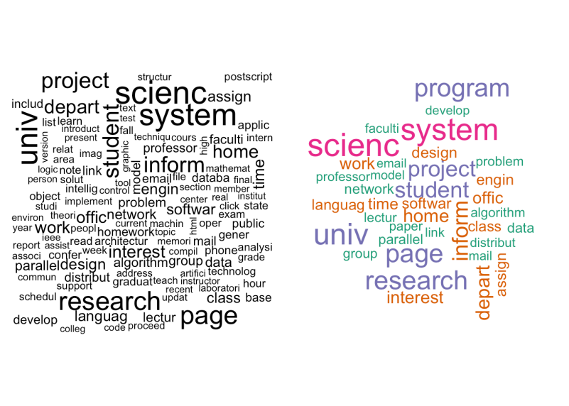
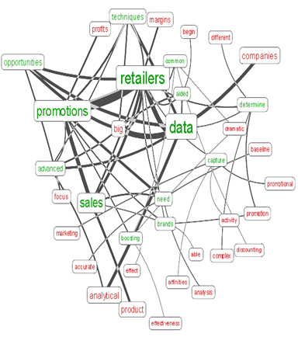
What is text mining
Text mining is the process of exploring and analyzing large amounts of unstructured text data aided by software that can identify concepts, patterns, topics, keywords and other attributes in the data.
The growth of Big data systems such shows exponential data generation rate more than 2.5 quintillion bytes per day.
95% of these big data are unstructured data containing text, audio and video.

Slide 3


Text Mining Applications
Information retrieval: Search engines
Language understanding: Siri (Apple)
Document classification: Spam filtering
Opinion mining: Twitter bran monitoring
…

Slide 4
What is Frequent Pattern Mining
One of the most significant subfields of data mining
Aims to discover useful, unexpected and interesting frequent patterns in databases
Pattern mining is an unsupervised classification
It puts relevant items in an item-set in terms of making groups for raw data.
Pattern mining can be used in many domains such as text mining
Some algorithms are designed to extract concise representations of frequent patterns such as frequent closed pattern.

Slide 5
Why frequent closed patterns are needed
Discovering numerous patterns cannot be useful to be analysed by human and machines
The redundant patterns can make high proportion of discovered itemsets
To reduce the number of patterns found
Provide more meaningful patterns

Slide 6
Frequent Closed Pattern Mining is a key function
Frequent Pattern mining
Frequent Closed Pattern Mining
Text Mining
Information Retrieval

Slide 7
The Purpose of My Project: How can we produce frequent closed pattern in more effective way
Reduce the complexity of the algorithms to be faster
Create a method to consume less memory

Slide 8
Scopes and Deliverables
This project has been carried out in four main scope and each scope has its deliverables:
Preparation
Analysing and finding new approach
Implementation and testing
Final results

Slide 9
Preparation The deliverables for this phase were:
An overall view of the pattern mining field and its basics
recognized specific fields in frequent closed pattern mining which have the potential to make a considerable changes
Project plan
Student agreement

Slide 10
Analysing and Finding Efficient Approach
The deliverables for this phase are:
Recognized gap for frequent closed pattern mining
Methods in this area suffered from time and memory consuming
Recognized pattern are not efficient ( sometimes, important patterns are not considered)
Specified methods to be implemented, tested and modified
NAFCP
dCHARM
DCI_PLUS

Slide 11
Implementation and testing
The deliverables of this scope are:
Implement on of the selected methods from previous phase which is NAFCP
Performance of selected method
Comparison with results of other approaches

Slide 12
Final result
Final results would be provided in some documents
The project presentation on week 13
The project report

Slide 13
How NAFCP works
Get a text data
Converts the data to a list of words
Eliminates stop words such as ‘The', 'a’, and…
Stemming words ( driving => drive)
Evaluate each words frequency
Eliminate ones with lower frequency than minimum support
Convert the list to a tree
Convert tree to a N-List
Use N-List to find frequent closed patterns

Slide 14




An Example

Slide 15
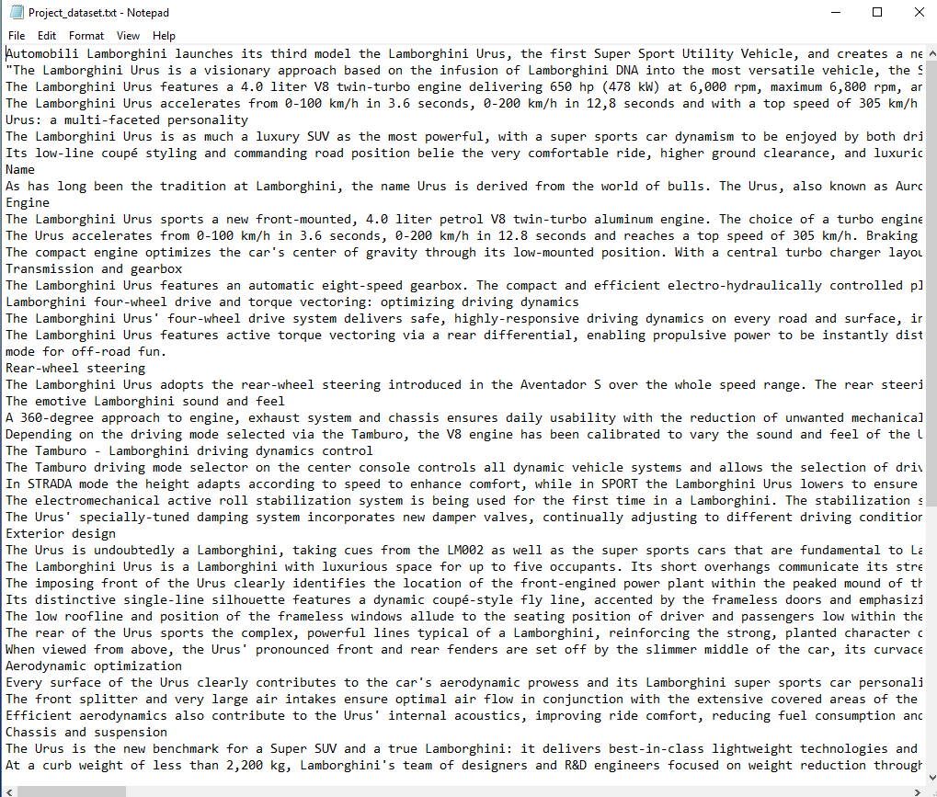
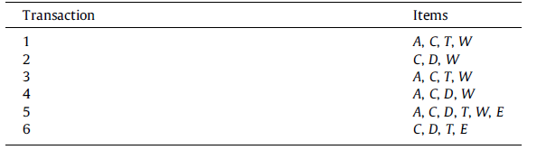
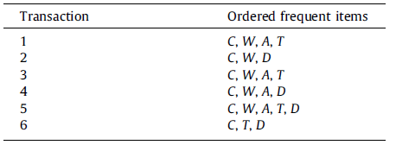
Get the text data Converts the data to a list of words Eliminates stop words such as ‘The', 'a’, and… Stemming words ( driving => drive) Evaluate each words frequency Eliminate ones with lower frequency than minimum support

Slide 16
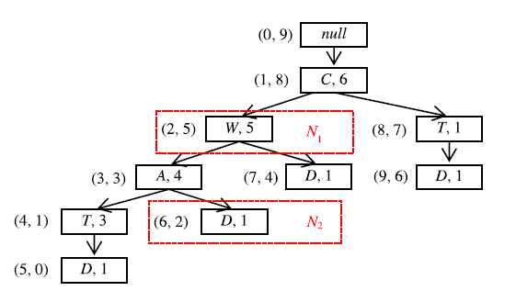
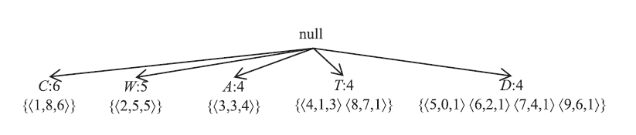
Convert the list to a tree Convert tree to a N-List

Slide 17
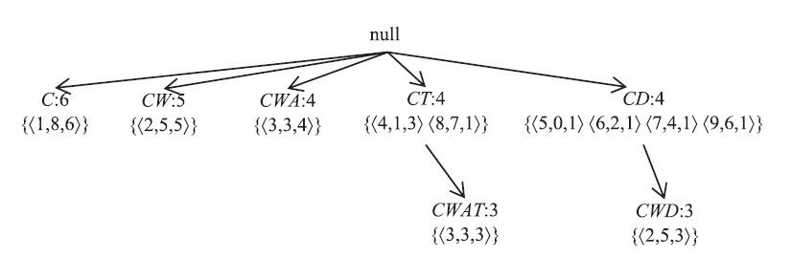
Use N-List to find frequent closed patterns

Slide 18
Results

Slide 19
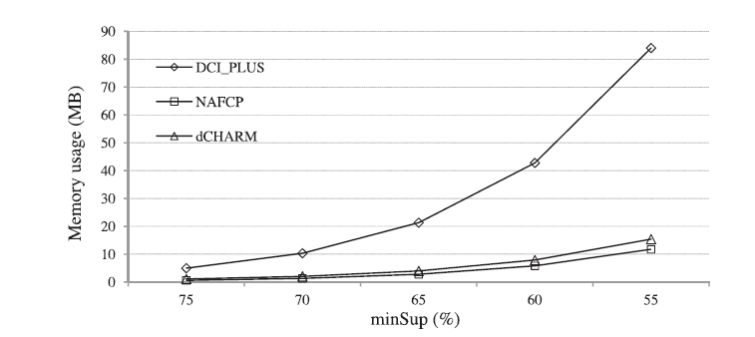
Outcomes
The implemented method has a remarkable performance in time and memory consuming
This method provide sufficient frequent closed pattern
According to the results the NAFCP is more efficient than dCHARM and DCI_PLUS

Slide 20
It can be used for:
Finding similar items
Documents Classification
Information extraction

Slide 21

Thank You

